Slide 1

Soul Sync-Wellness App
Digital partner for wellness
Yash Panchani
Vidhi Parekhiya
Moldir Nurmakhan
Team 4
README.md

Slide 2
Technology Used
Programming Language: Kotlin
UI Framework: Jetpack Compose
Requirement
Android Device

Slide 3
Description of Problem
Many individuals struggle to manage their emotions and cope with feelings such as anxiety, sadness, and depression.
These emotional challenges can adversely impact relationships, work performance, and overall quality of life.
SoulSync aims to address this problem by providing a solution to track, understand, and improve emotional health.

Slide 4
Competitive Analysis
The demand for digital mental health solutions continues to rise, among younger tenagers who seek accessible tools for stress and anxiety management.
BetterHelp App-An online therapy platform offering access to licensed therapists through text, video, and voice calls.

Slide 5
Description of Users
College Student
New Parents
Self Improvement
Stressed Professional

Slide 6
Emotional Based Activity
Mood Tracker
Features
Based on mood Quotes
Feed (Future enhancement)

Slide 7
Design Highlights

Slide 8
Development Status of the SoulSync App
Implemented Features
Functional Navigations:
Splash Screen
Login/Register
Home Screen
2. Button Navigations:
Mood Selection
Mood Tracker
Notes
Tips
Feed with videos and articles(Future Update)

Slide 9
improved ability to create apps that make users feel real and improve their experience.
Current Progress:
All the navigations and screens are working perfectly.
UI design align correctly.
The app is functioning as intended.

Slide 10


Beneﬁts
Manage emotions effectively.
Improve emotional intelligence over time
Acesssible to mental health support

Slide 11
Learning Experience:
Gained hands-on experience in UI development and gained an understanding of the Android system by giving equal attention to all screen details.
We faced some problems to implement complex navigation flows but we learned how to improve flawless navigation between two screen.
Improved ability to create apps that make users feel real and improve their experience.
Future Work:
Use Firebase or a similar backend service to safely store and retrieve user data like, mood tracking and notes.
Add mood tracking analytics so that user can get their data as a chart.
Improve UI design and navigations to increase user journey.

Slide 12
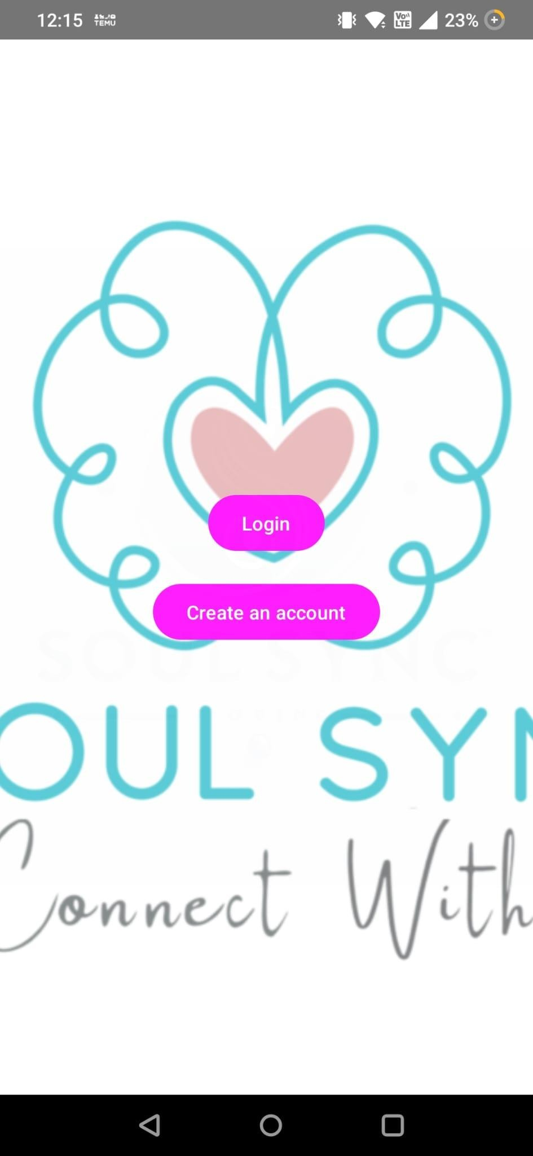
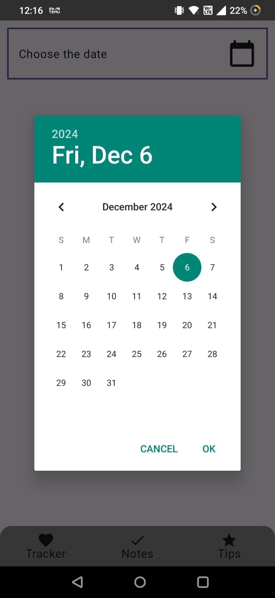
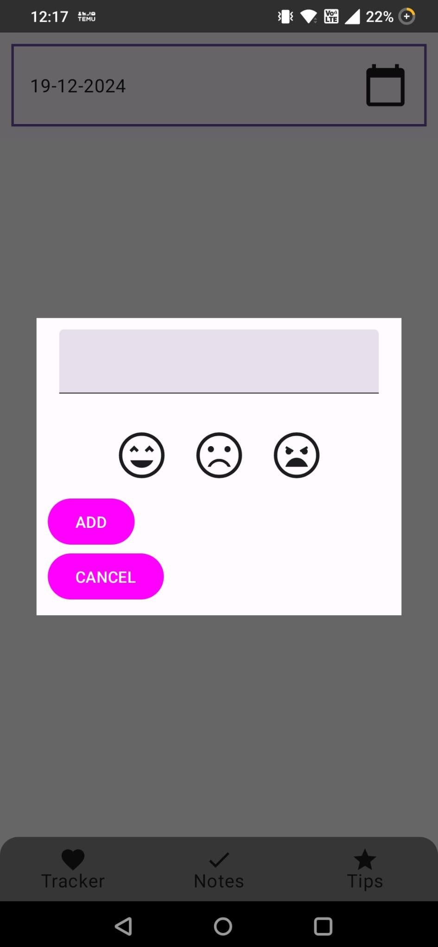
Screenshots

Slide 13
Conclusion
SoulSync makes mindfulness part of everyday life,helping user build healthier,more fulﬁlling relationship with emotions.

Slide 14
Soul Sync-Wellness App
Digital partner for wellness
Yash Panchani
Vidhi Parekhiya
Moldir Nurmakhan
Team 4
README.md

